Slide 1
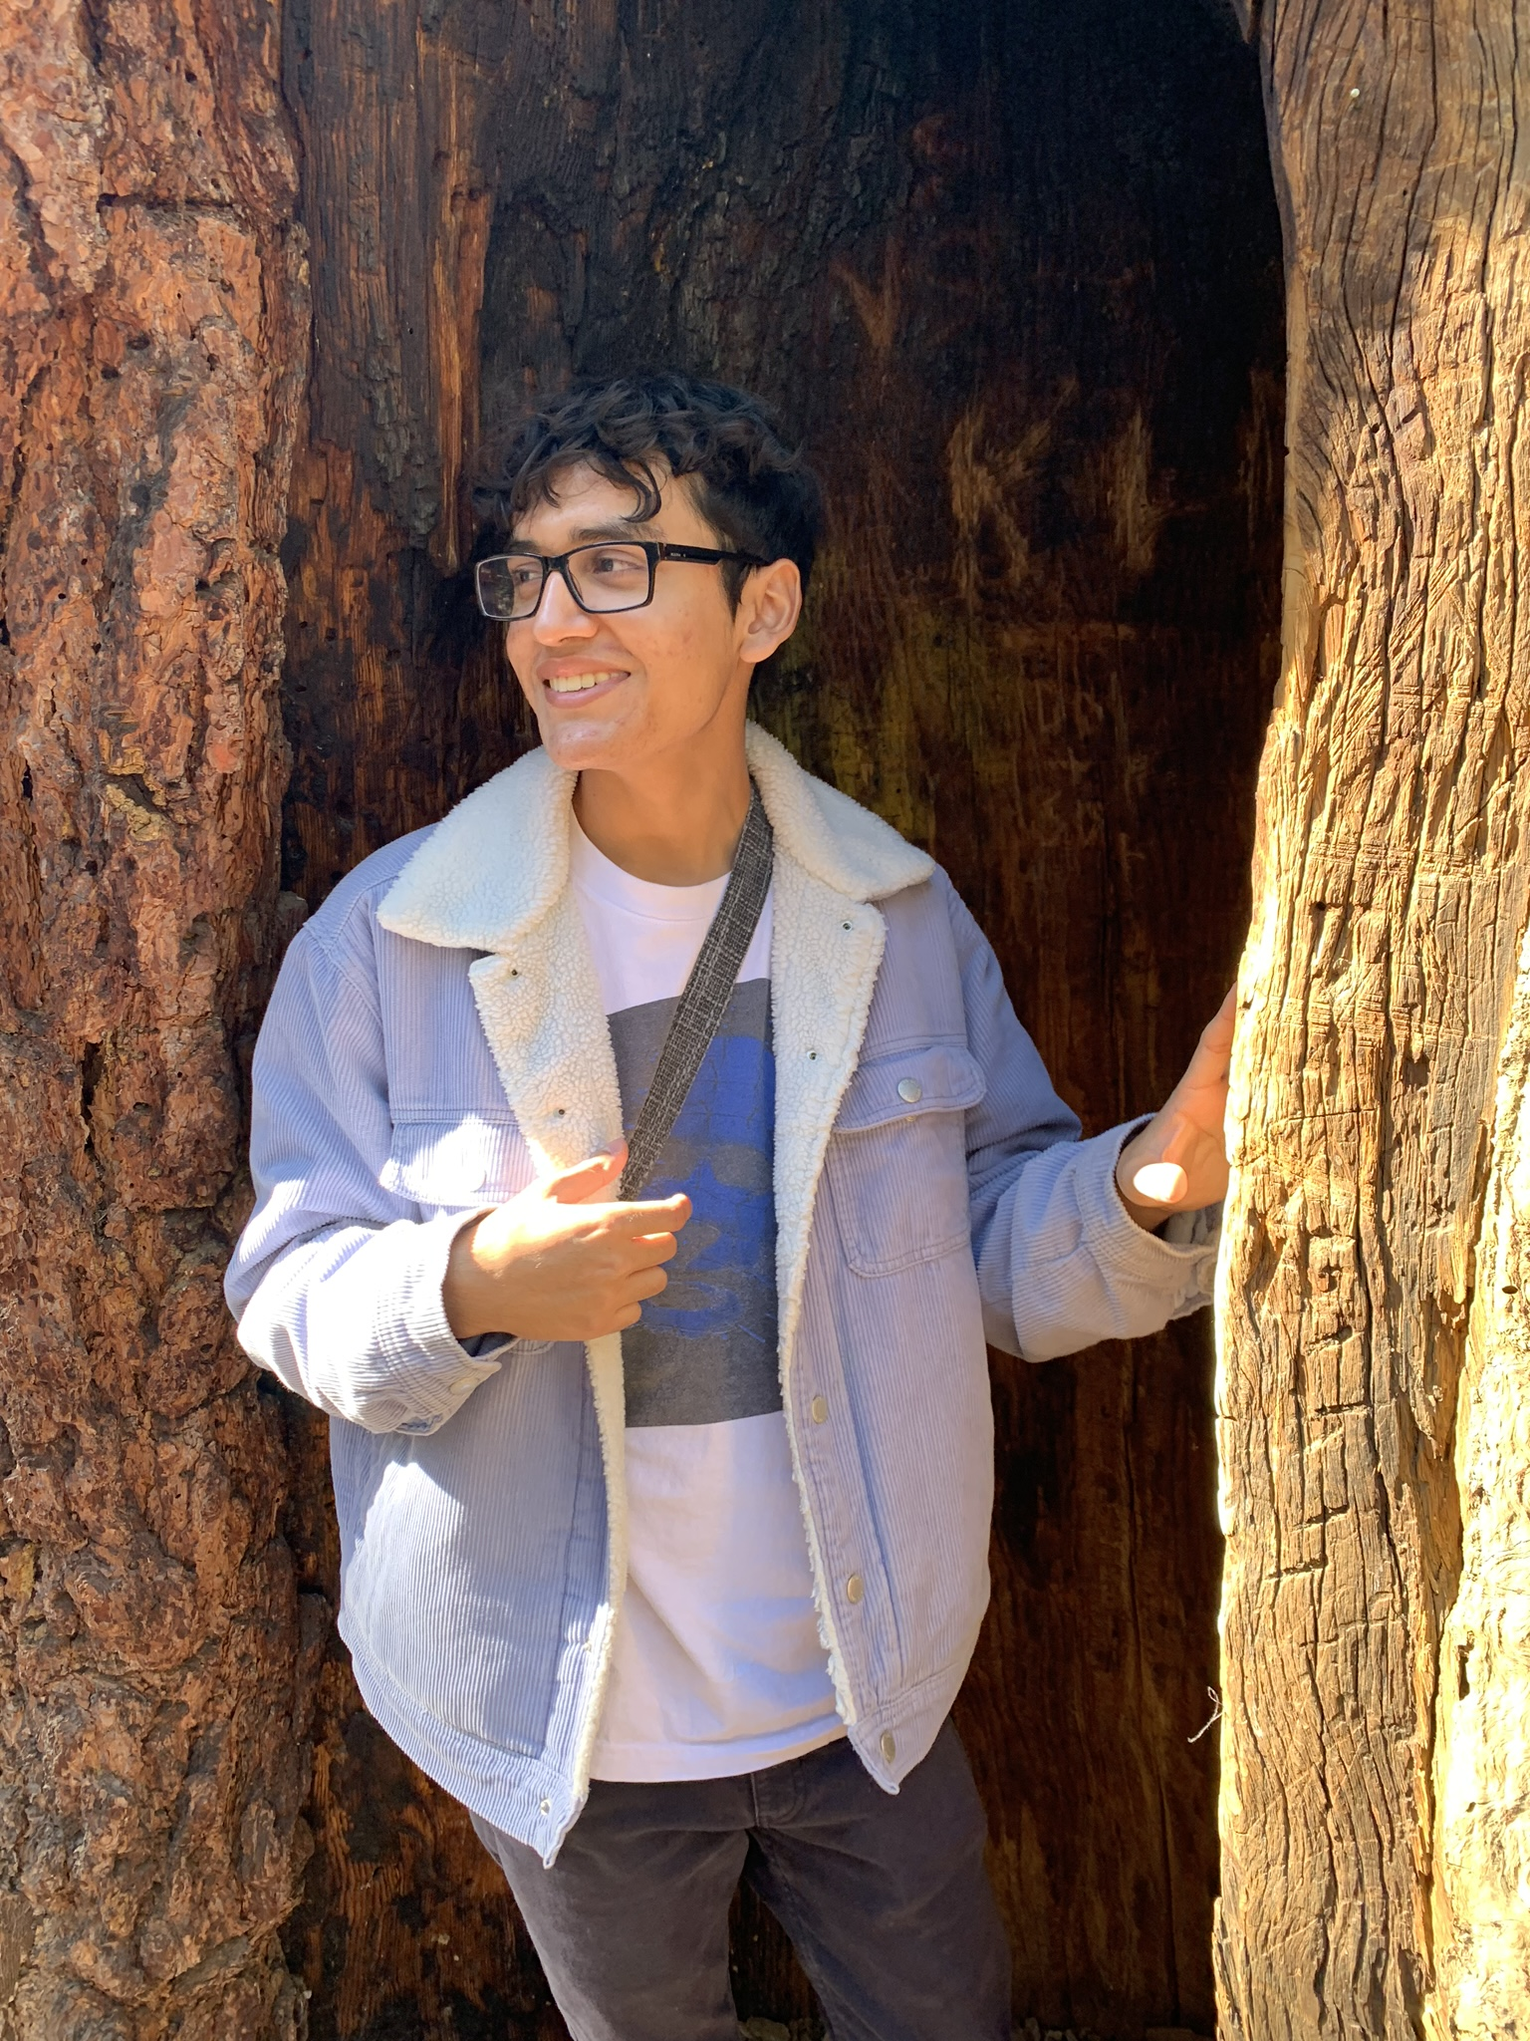
Alexis Anaya (HE/HIM) Bachelor of Political Science AND Sustainability Studies
FAVORITE HAPPY MEMORY OF UCR: was all the time that I’ve spent with my friends
MY ONE PIECE OF ADVICE IS: Don’t be afraid to go out of your comfort zone.

Slide 2
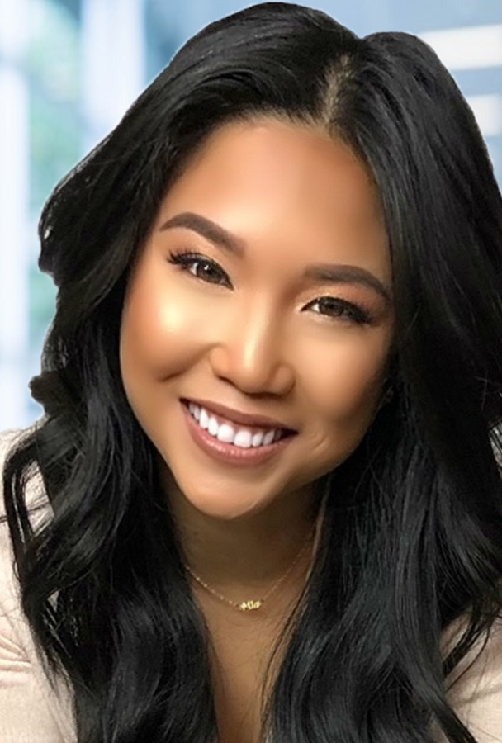
Brittney Jasmine Agoncillo (she/her) Bachelors of Science in Business Administration, with a concentration in information Systems
FAVORITE HAPPY MEMORY OF UCR:
Holding my wife's hand on the way to our class while feeling safe and welcomed. Being the co-president of The Management Information Systems Society at UCR. Creating the first virtual Information Systems Tech Forum at UCR.
MY ONE PIECE OF ADVICE IS:
Your success is inevitable if you keep showing up.

Slide 3
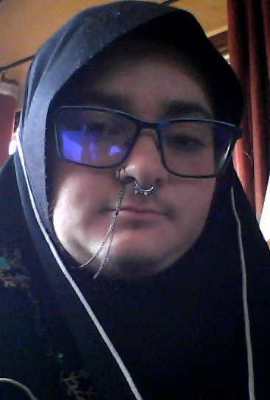
Claus Lucas Lopez (HE/HIM) Bachelor of Arts in Religious Studies and Creative Writing

Slide 4
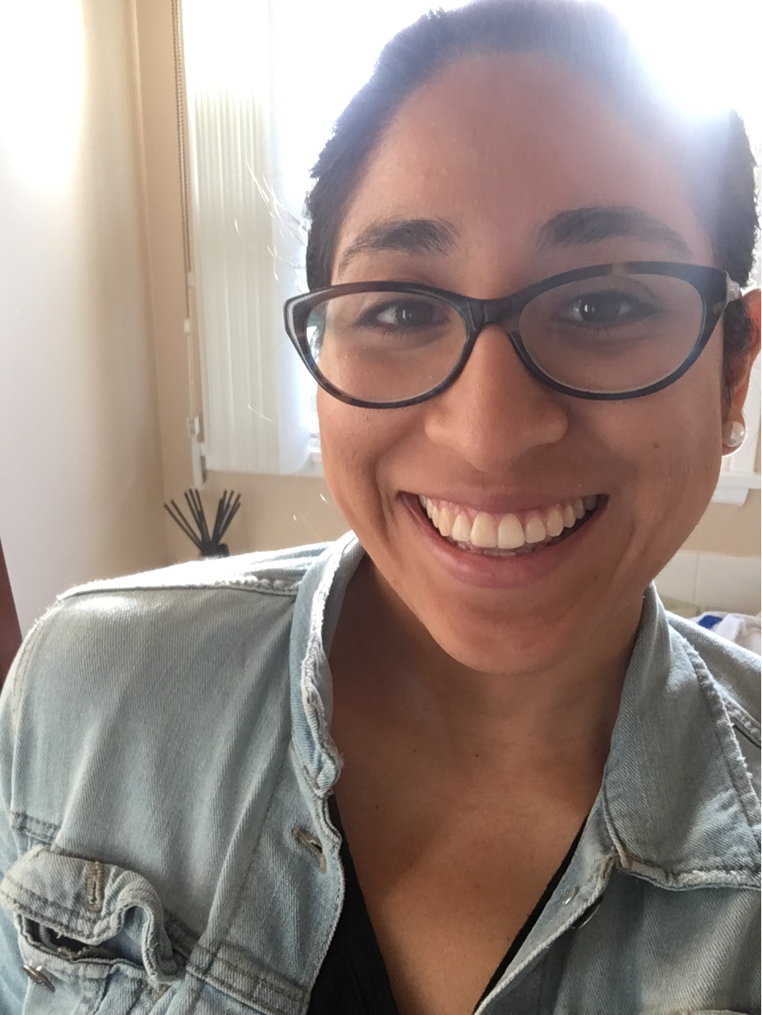
Diana Gutierrez (SHE/HER) Bachelor of Ethnic Studies
FAVORITE HAPPY MEMORY OF UCR: was discovering more of myself via what readings I loved.
MY ONE PIECE OF ADVICE IS:
Breathe and ask questions :)

Slide 5
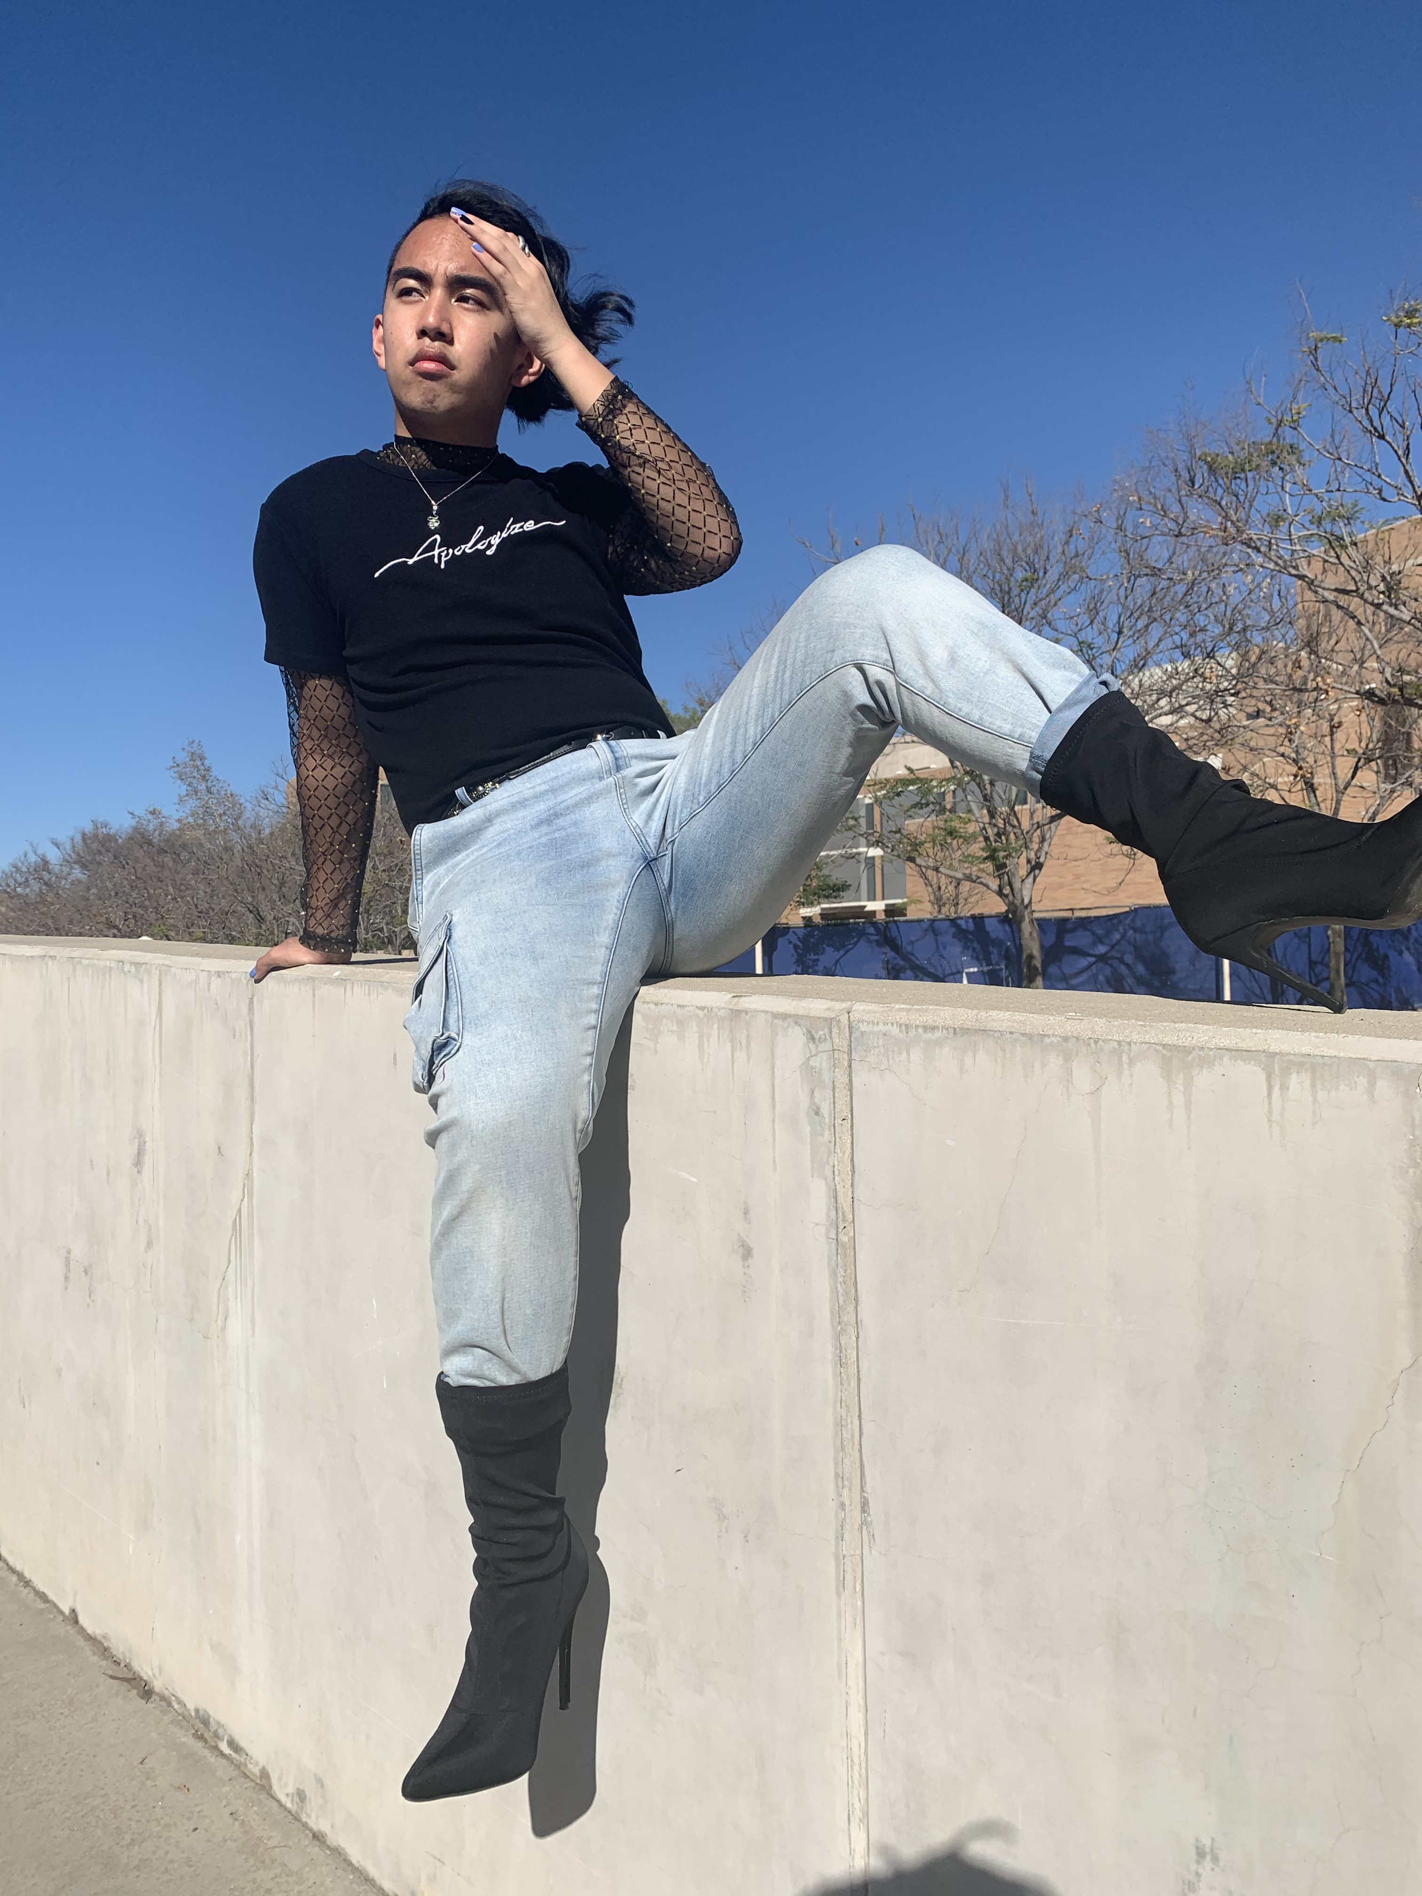
Edward Legaspi (HE/HIM) Bachelor of Science, Business Major w/ Concentration in Management
FAVORITE HAPPY MEMORY OF UCR: would be anytime connecting with my queer friends/community. This spans from my time at Queer Alliance, having fun at Drag Ball and the Underground Drag Show, and telling our stories at The Coming Out Monologues. I hold my queer friends (shoutout to Alexis Anaya and Marcus Keck!) that have been with me all these years and my House of Lauren very dearly.
MY ONE PIECE OF ADVICE IS:
I would advise them to make sure they are studying something they enjoy. And I would also advise coming out of that study space and finding a community you can thrive in. I know we must focus on our studies, but it is life changing finding a community that will support and watch you thrive during your time at UCR.

Slide 6
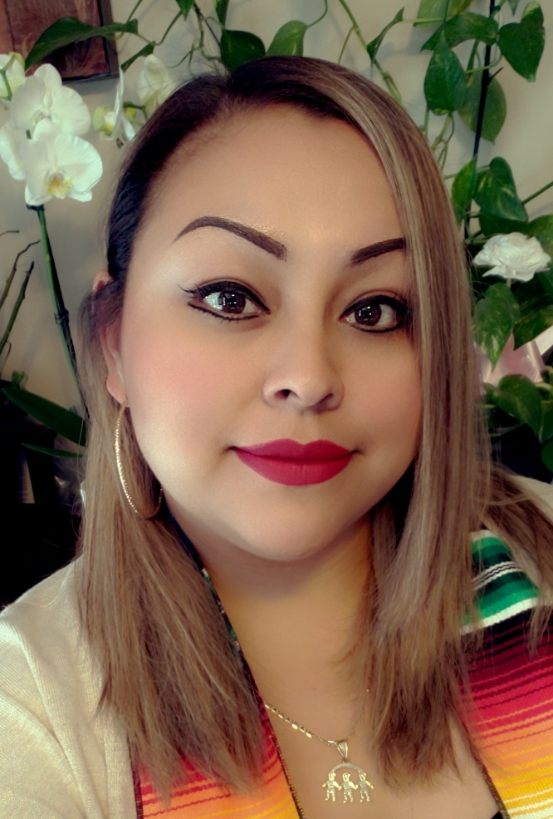
Jacqueline Hernandez (she/her/ella) Masters of Education in Higher Education Administration & Policy
FAVORITE HAPPY MEMORY OF UCR:
As a graduate student, my favorite part at UCR was getting the opportunity to peer mentor! I experience great satisfaction in providing support and being resourceful for undergraduate students. I have been so lucky to be paired with such amazing people.
MY ONE PIECE OF ADVICE IS:
Get involved on campus and participate in as many events as you can!

Slide 7
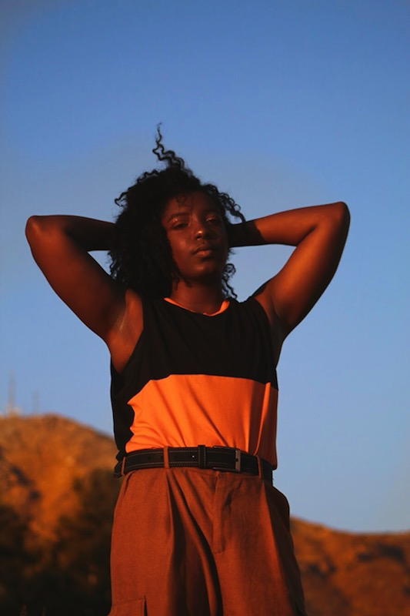
Kade Lorén Lashley (THEY/THEM) Bachelor of Sociology
FAVORITE HAPPY MEMORY OF UCR: was every moment I spent in solidarity with the community I made for myself there. Whether we were struggling together or taking time out for joy together. In a way, I loved all of it.
MY ONE PIECE OF ADVICE IS:
Show up for others when you have the capacity and remember those who show up for you.

Slide 8
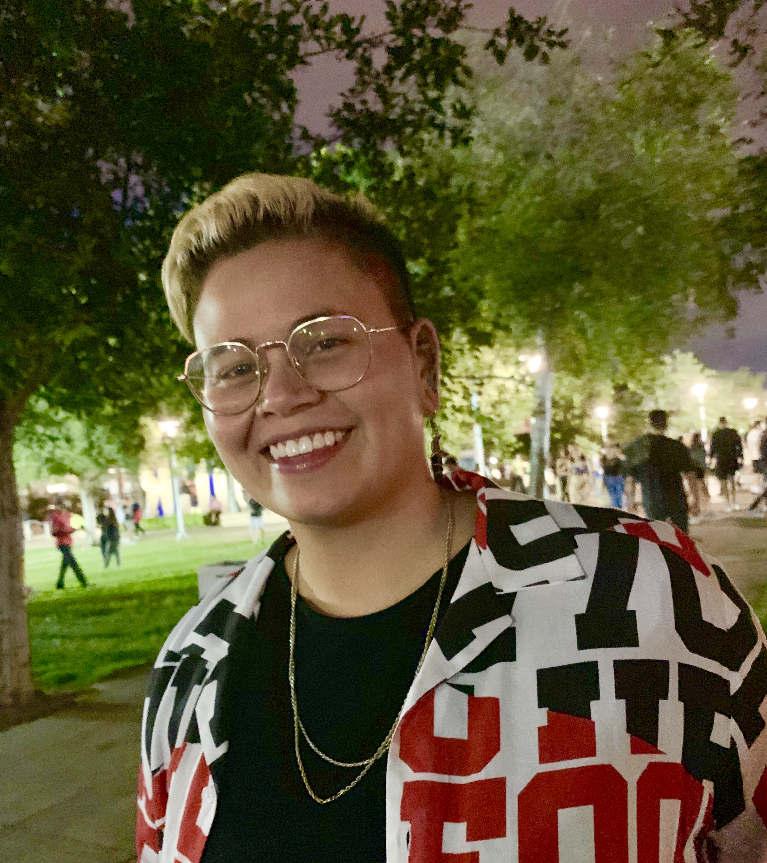
Kay Duran (she/her) Bachelor of Sociology
FAVORITE HAPPY MEMORY OF UCR: was Block Party and meeting new people. Especially my MUjeres Unidas sisters
MY ONE PIECE OF ADVICE IS:
Stay focused, you’re almost there!

Slide 9
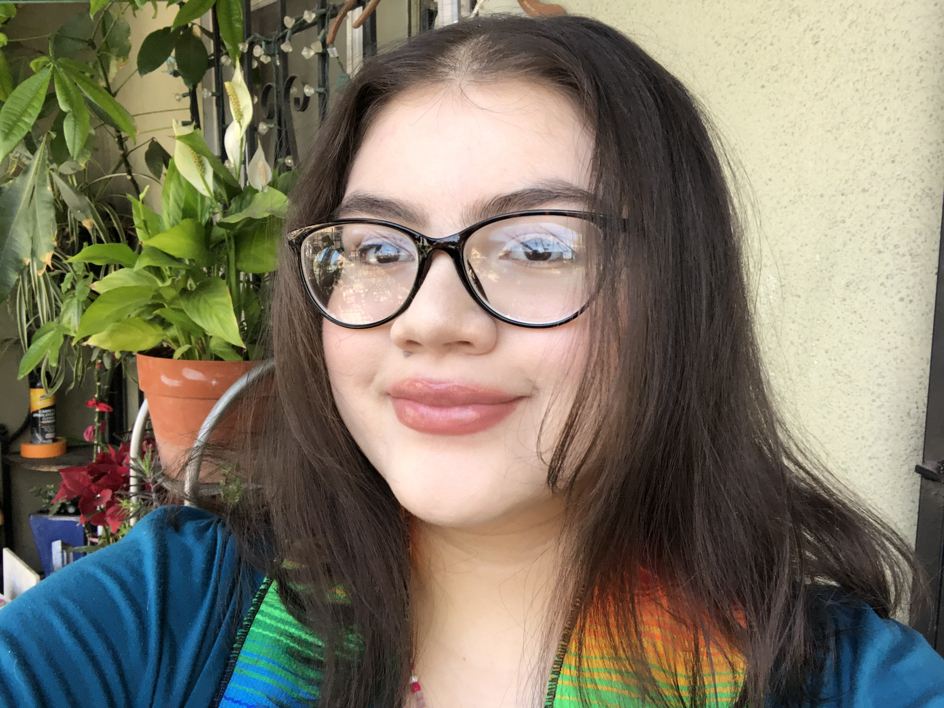
Keiry Molina (SHE/HER) Bachelor of Sociology
FAVORITE HAPPY MEMORY OF UCR: was sitting at the HUB with my best friend eating and laughing together :)!
MY ONE PIECE OF ADVICE IS: Please be kind to yourself, you’re putting in the work for your education, make sure you’re always okay.

Slide 10
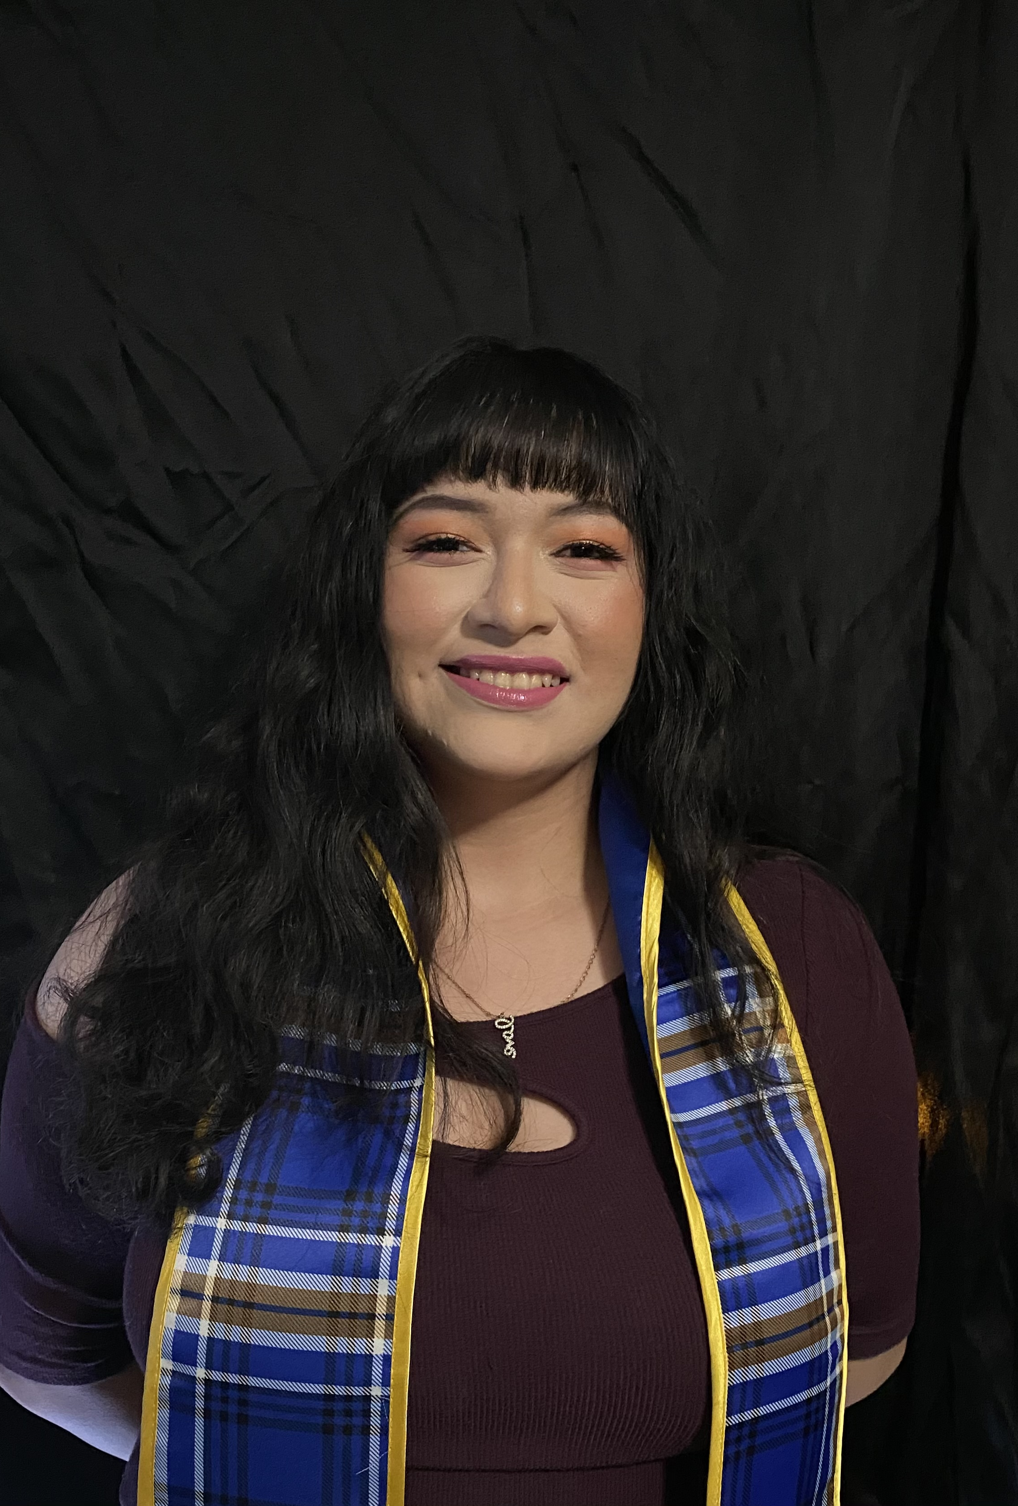
Rei Sierra Gomez (All Pronouns are Fine) Bachelor of Dance Making
FAVORITE HAPPY MEMORY OF UCR: was creating choreographies alongside my cohort and dancers for my senior capstone. As much as it was stressful, it is still the one moment in time I wish I could go back to to relive.
MY ONE PIECE OF ADVICE IS:
One piece of advice I would give to an undergraduate still working on their degree is to really use all the free resources UCR is giving you, such as R’Closet, the Career Center, Costco Hall, etc. before it is too late!

Slide 11
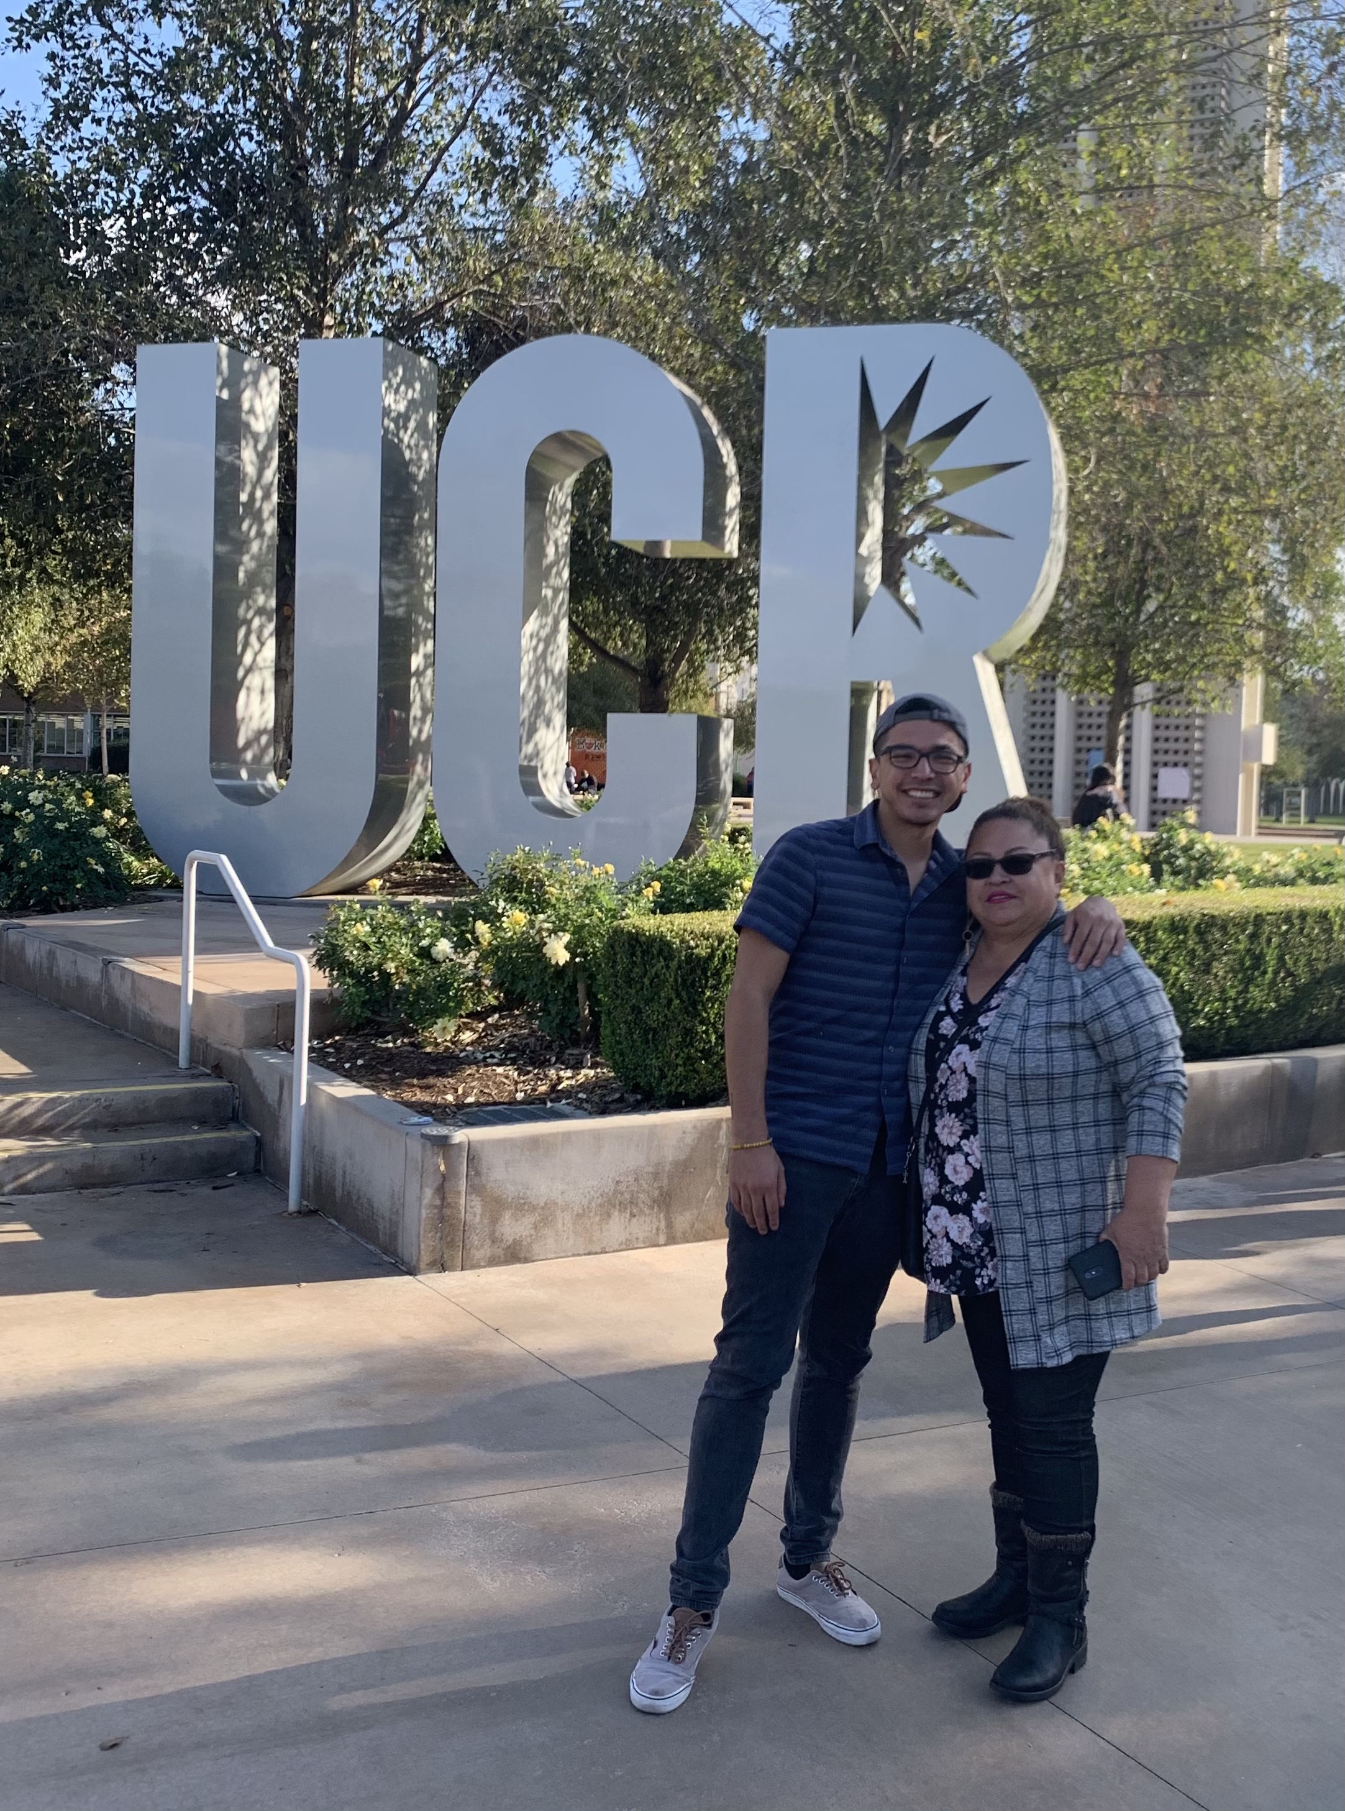
Ricardo De Jesus Palacios (HE/HIM) Bachelor of Business Administration with a concentration in Information Systems
FAVORITE HAPPY MEMORY OF UCR: was giving my beloved mother a tour of the entire campus and seeing her beautiful eyes light up the minute she saw the UCR letters. In that moment I knew that I’ve reached a goal more valuable than anything else and that was her happiness. She expressed how proud she was of me as we both cried sitting next on Scotty’s bench.
MY ONE PIECE OF ADVICE IS:
My piece of advice is to fill your heart with as much love as possible for yourself, your loved ones, and your true passion.

Slide 12
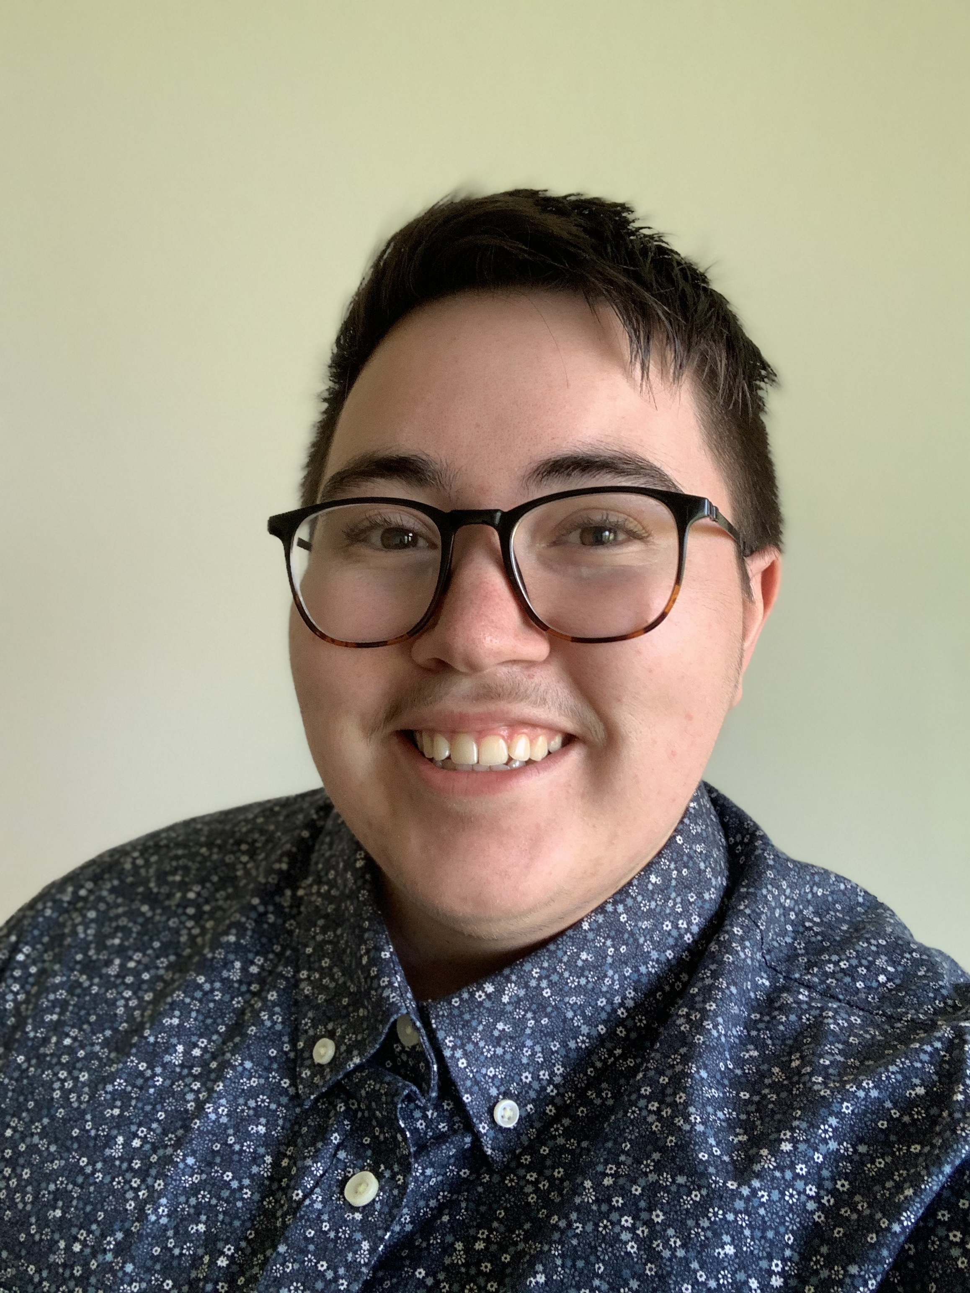
Ryan August Schlott (HE/HIM) Bachelor of Linguistics
FAVORITE HAPPY MEMORY OF UCR: was playing card games with CORE after hours. We all hung-out in the lounge and just had a great time with one another. Nothing compares to connecting with our community.
MY ONE PIECE OF ADVICE IS: Getting involved on campus will help you succeed now and in the future.

